Slide 1
Analysis of Tornadoes, Rip Currents, and Hurricanes in the US in 2020
By Luke Abbatessa & Ciara Malamug

Slide 2
The Dataset
National Weather Service (NWS) Database
Storm data from 2020 (last complete year in the database)
Separated into detail, fatalities, and location files
Analyzed separately
Hurricanes and Rip currents didn’t have longitude and latitude data
Data cleaning:
Converted numerical number place holders into their respective numbers
E.g. K → 1000, M → 1,000,000
Omitted Na values

Slide 3
The Question
What are the previous locations, meteorological patterns, and economic damage rates of tornadoes, rip currents, and hurricanes in the US in 2020?

Slide 4
The Insight

Slide 5
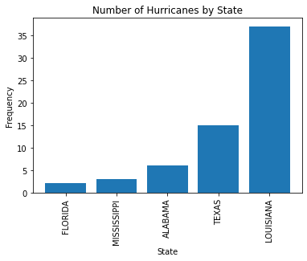

Slide 6
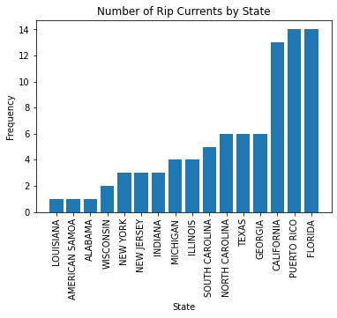

Slide 7
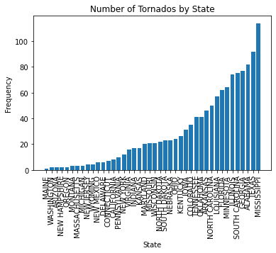

Slide 8
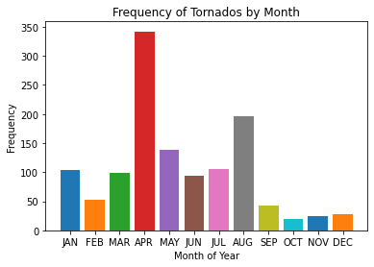
Notes:
NOAA National Severe Storms Laboratory - Depending on where u are it can be early spring to early summer

Slide 9
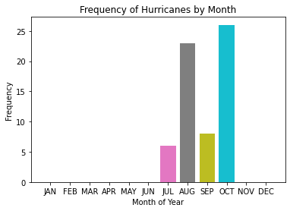
Notes:
May to novenber

Slide 10
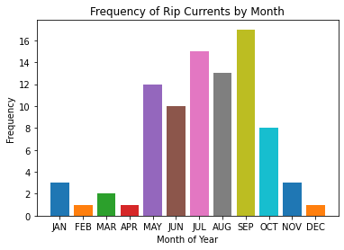

Slide 11
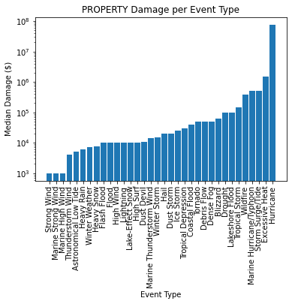

Slide 12
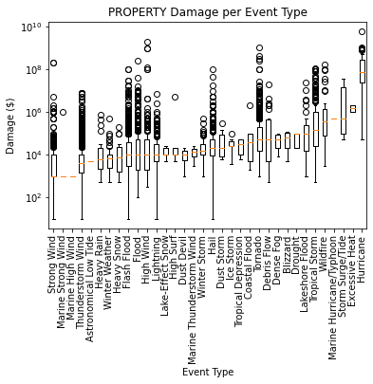

Slide 13
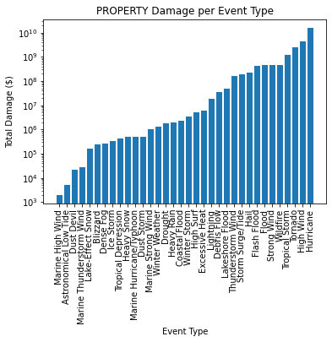

Slide 14
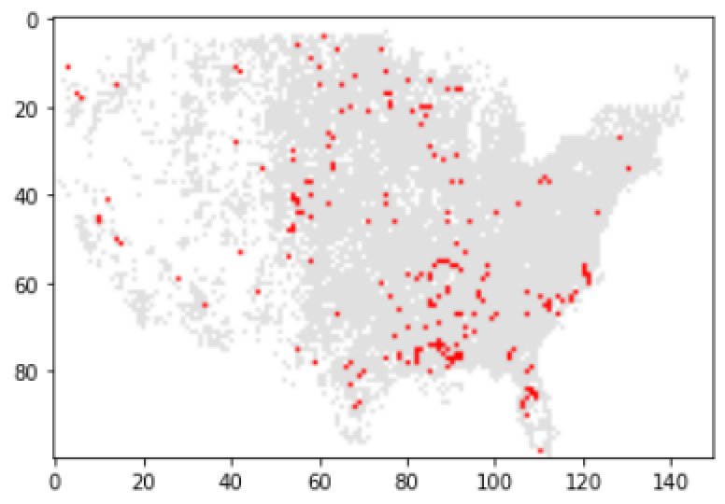
Latitude-Longitude Scatterplot of Tornado Occurrences
NOTE: rip currents and hurricanes had no data with regards to their latitudes and longitudes

Slide 15
Statistical Testing: Shapiro-Wilk normality test
To check for normality among the distributions of data regarding both property damage and crop damage across the different event types (tornado, rip current, hurricane), multiple Shapiro-Wilk tests were run
Null hypothesis: The data come from a normal distribution
Alternate/Alternative hypothesis: The data do not come from a normal distribution
In each of the six tests ran for 2020, the p-value was less than alpha = 0.05, thus the data did not come from a normal distribution
NOTE: Shapiro-Wilk tests weren’t conducted for either damage rate for rip currents because no property damage nor crop damage was caused by this event

Slide 16
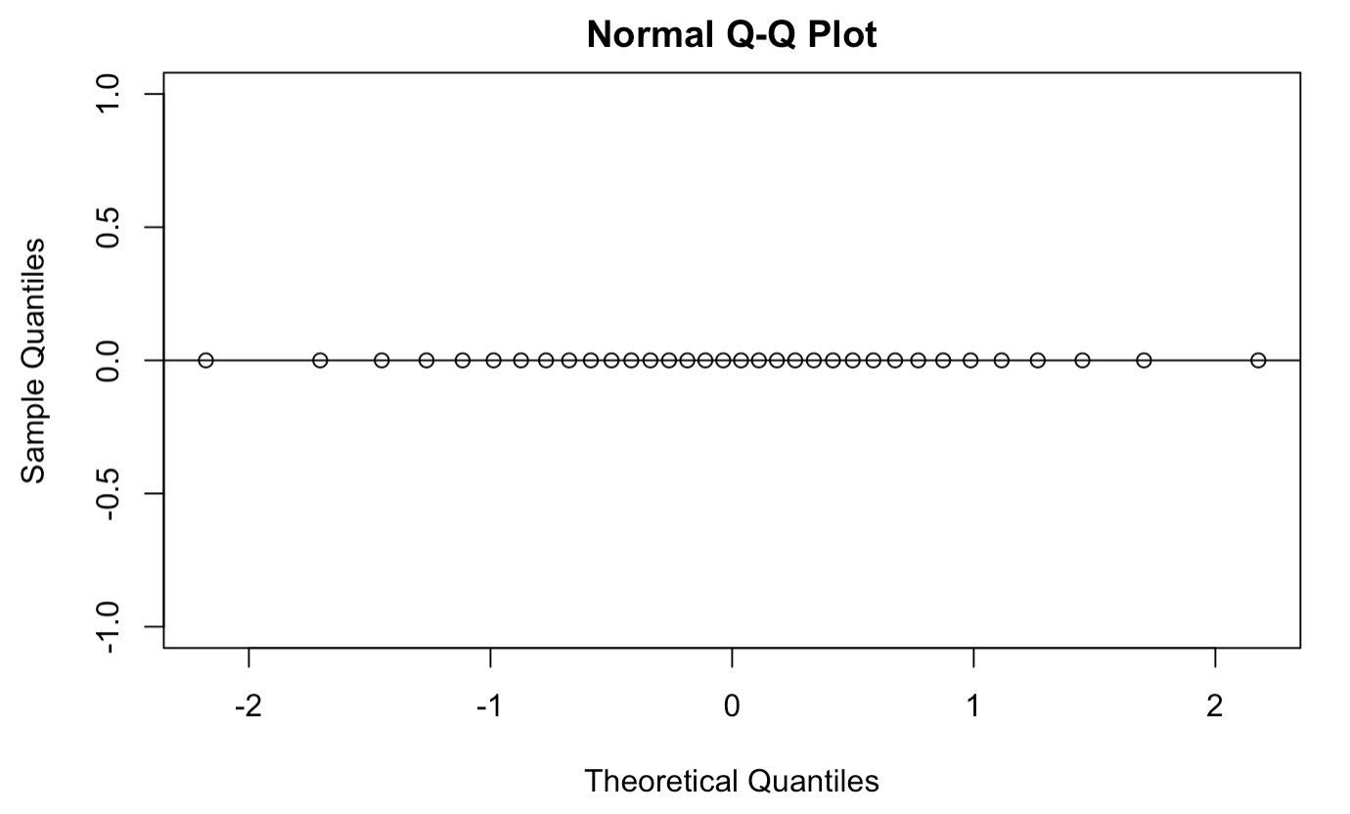
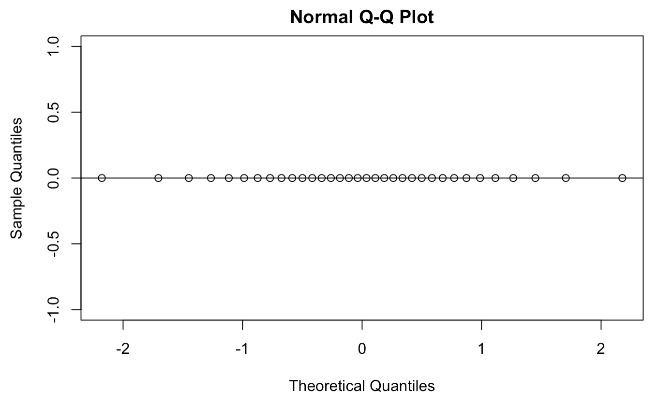
Statistical Testing: Quantile-Quantile (Q-Q) plots
For the associated damage rates and event types not demonstrated by Shapiro-Wilk tests, Q-Q plots were used as an alternative metric of testing for normality
property damage, rip currents
crop damage, rip currents
Each of these plots are (or at least appear to be) normally distributed

Slide 17
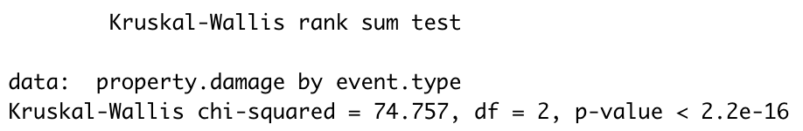
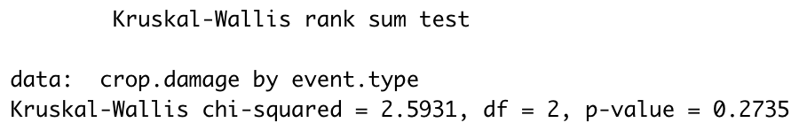
Statistical Testing: Kruskal-Wallis rank sum test
To compare the mean damage rates for the events across locations, two Kruskal-Wallis tests were run: one for property damage, one for crop damage
Null hypothesis: All group median ranks regarding _____ (crop/property) damage across event types are equal
Alternate/Alternative hypothesis: At least one pair of event types have different median ranks

Slide 18
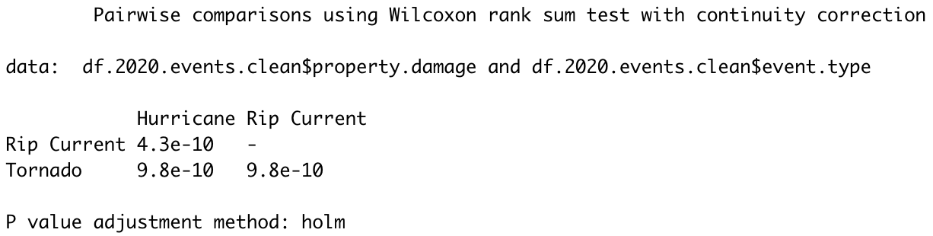
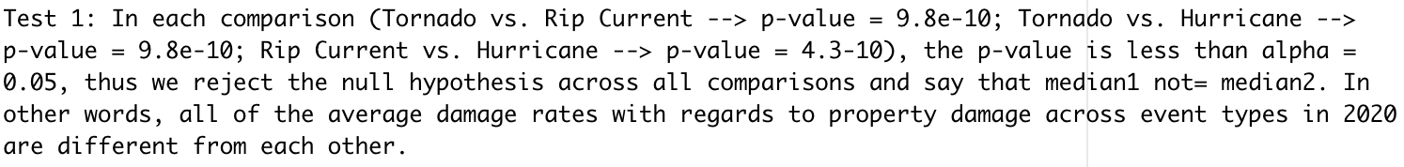
Statistical Testing: Mann-Whitney U test
Given that the average property damage rates for tornadoes, rip currents, and hurricanes were not all equal to each other, a Mann-Whitney U test was run to see which average damage rates were different from each other
Null hypothesis: median1 = median2, with regards to _____ (crop/property) damage across event types
Alternate/Alternative hypothesis: median1 not= median2

Slide 19
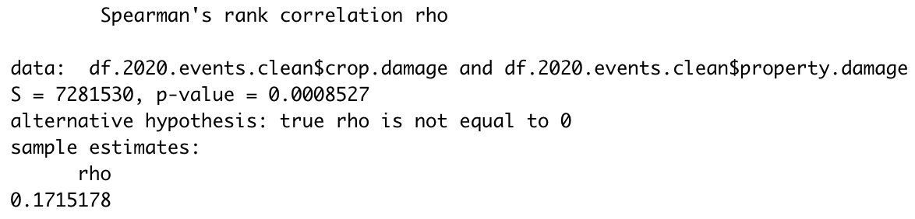
Statistical Testing: Spearman rank correlation test
To test for the correlation between crop damage (explanatory/independent variable) and property damage (response/dependent variable), a Spearman rank correlation test was run
Null hypothesis: Spearman rank correlation = 0, with regards to crop and property damages
Alternate/Alternative hypothesis: Spearman rank correlation not= 0

Slide 20
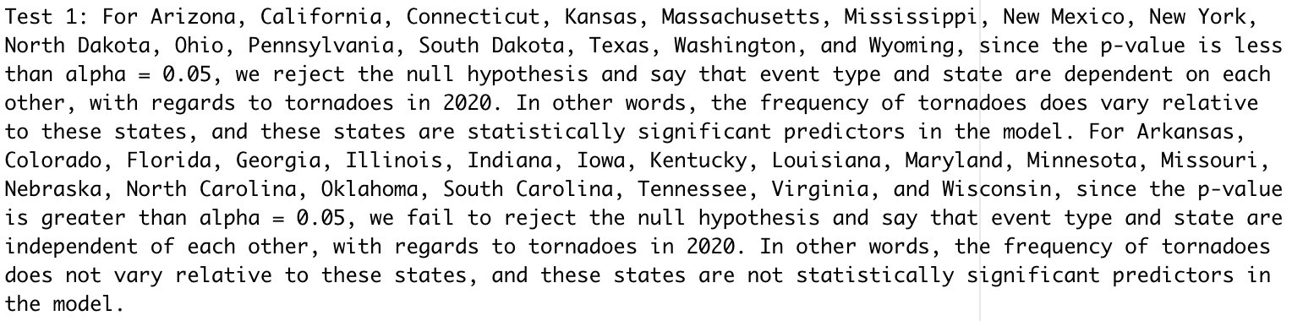
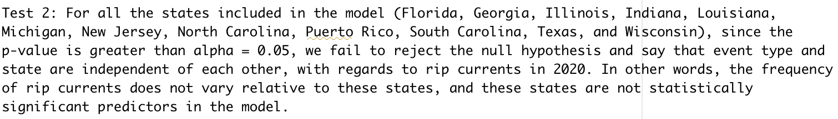
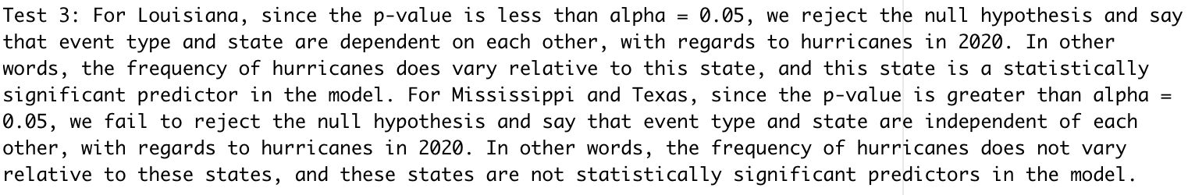
Statistical Testing: Poisson regression/G-test
To determine whether the frequency of each disaster varies by state, three respective Poisson regressions/G-tests were run
Null hypothesis: Event type and state are independent of each other, with regards to _____ (tornadoes, rip currents, hurricanes)
Alternate/Alternative hypothesis: Event type and state are dependent on each other

Slide 21
Additional Information
Implemented a KNN model to try to predict storm type by longitude and latitude
Created word clouds based on the description of the storm type from the data
Graphed the mean, box-and-whiskers plot, and total damage for crop damage
Notes:
Things that we implemented but didn’t draw reasonable results from

